Slide 1
Job Matching Database
How a college placement cell keeps students, companies, and applications straight — in one MySQL schema.
12
8
4
2
Tables
Views
Triggers
Procedures
Built on MySQL 8 · reviewed for logic gaps before it ships

Slide 2
Project Details
PROJECT TITLE
AI-Assisted Resume and Job Matching Database
TEAM MEMBERS
Sr. No. | Name | PRN
1 | Ria Mudhole | 1262251691
2 | Mansi Kumari | 1262251426
3 | Aditya Agarwal | 1262251124
4 | Dhani Jain | 1262251217
RM
MK
AA
DJ
Job Matching Database
2

Slide 3
Problem Statement
Why a placement cell needs more than a spreadsheet
The problem
This project's answer
College placement cells juggle hundreds of students, dozens of recruiting companies, and thousands of resume submissions — usually across spreadsheets that go stale the moment a job closes or a CGPA is updated.
An AI-assisted MySQL database that:
• Verifies a company before any of its jobs go live
• Tracks every resume version and status change automatically
• Computes the exact skill gap between a student's profile and a job's requirements
• Gives a data-backed answer to ‘am I qualified for this?’ — instead of a guess
• No reliable way to confirm a student actually meets a job's requirements before they're nudged to apply.
• No single source of truth for what changed on an application, when, or why.
Job Matching Database
3

Slide 4
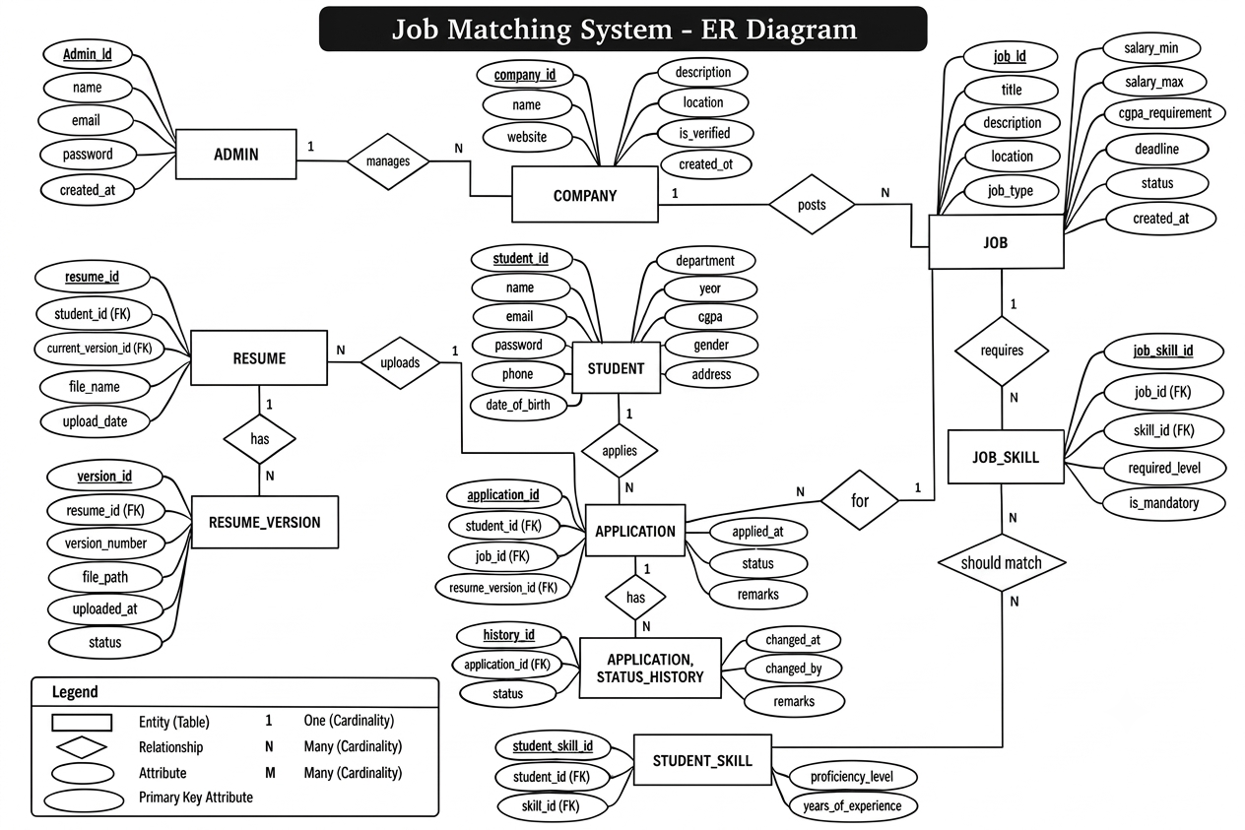
ER Diagram
Ten entities and their relational tables, side by side
Job Matching Database
4

Slide 5
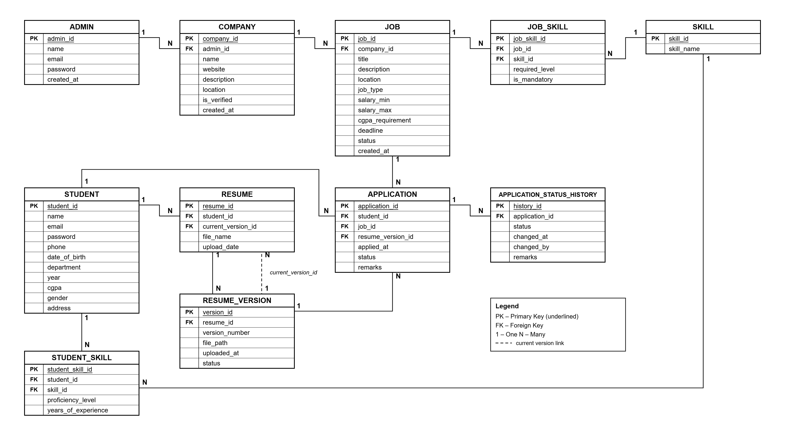
Relational Schema
Ten entities and their relational tables, side by side
Job Matching Database
4

Slide 6
What's actually in here
Twelve tables, but they fall into four groups you can hold in your head
1
Who's using it
2
The skills graph
ADMIN · STUDENT
SKILL · STUDENT_SKILL · JOB_SKILL
Just the people: staff logins, and every student's department, year and CGPA.
One shared list of skills, so a student's Python and a job's Python are the same row.
3
The hiring side
4
The paper trail
COMPANY · JOB
RESUME · RESUME_VERSION · APPLICATION · APPLICATION_STATUS_HISTORY
Companies have to be verified before a single job of theirs can go live — enforced by a trigger, not just a form.
Every resume version and every status change is kept, so nothing about an application is ever a guess.
Job Matching Database
5

Slide 7
Let's trace one student through it
Using the sample data already sitting in the tables — no hypotheticals
RS
Rahul Sharma
Python Developer Intern
✓ He qualifies
Computer · Year 2
Tech Solutions · Pune
CGPA clears the 7.50 bar, and both required skills are on his profile.
CGPA 8.50
Needs CGPA ≥ 7.50
His skills on file:
What it's asking for:
GetSkillGap would say:
• Python — Intermediate
• Python — Intermediate (required)
Nothing missing — the only gap is Git, and that's optional.
• SQL — Advanced
• SQL — Intermediate (required)
• HTML — Intermediate
• Git — Beginner (nice to have)
Worth knowing:
2 resume versions on file
Deadline: 31 Dec 2027 · still open
GetStudentJobs itself only checks for one shared skill, not all required ones — Rahul happens to pass either way.
Applies with resume v2
Job Matching Database
6

Slide 8






The database looks after itself
Four triggers stop bad data before it lands; two procedures do the matching legwork
WHAT THE TRIGGERS CATCH
WHAT THE PROCEDURES DO
An unverified company tries to post a job
GetStudentJobs(id)
Blocked outright — verification has to happen first.
“What should I even apply to?” — every open, qualifying job in one call.
A student applies after the deadline
GetSkillGap(id, job)
Blocked — same if the job's been closed.
“What am I missing?” — the exact skills a student still needs for one job.
Someone attaches a resume that isn't theirs
Blocked — the resume has to belong to the applicant.
An application's status changes
Logged automatically, from the very first 'Applied'.
Job Matching Database
7

Slide 9








Results
Eight views turn common questions into a single ready-made query
JOBS & COMPANIES
“What jobs are open right now?”
“Is this company legit yet?”
ACTIVE_JOBS
COMPANY_VERIFICATION_REPORT
APPLICATION PIPELINE
“How many applied to this job?”
“Where’s everyone in the pipeline?”
JOB_APPLICATION_REPORT
APPLICATION_STATUS_REPORT
MATCHING & SKILLS
“Who’s a good fit for what’s open?”
“What can this student actually do?”
STUDENT_JOB_MATCHES
STUDENT_SKILL_REPORT
HISTORY & DEMAND
“What happened to this application?”
“What skills are companies chasing?”
APPLICATION_HISTORY_REPORT
MOST_DEMANDED_SKILLS
Job Matching Database
8

Slide 10
Review 2: Implementation Deliverables
DDL, DML, relational algebra, PL/SQL, and the front-end that talks to all of it
1
DDL Statements
2
DML Queries
3
Relational Algebra
Create-table scripts for all eleven tables, with column- and row-level constraints (NOT NULL, CHECK, FOREIGN KEY) enforced in the schema — not just in application code.
Ten-plus real user requests — “what jobs are open for me”, “who applied to this posting” — written first in plain English, then mapped to the SQL that answers them.
Each DML query is first written as a relational algebra expression, then translated to SQL.
π title, location ( σ is_active = 1 ∧ deadline ≥ today ( JOB ) )
σ → WHERE · π → SELECT · ⋈ → JOIN
4
PL/SQL Blocks
5
Front-End
GetStudentJobs and GetSkillGap as procedures with cursors, plus supporting functions and the four triggers already covering verification, deadlines, resume ownership, and status logging.
A Python + Streamlit interface, connected to MySQL via mysql-connector-python, giving students and staff a UI over the queries and procedures above.
Job Matching Database
9

Slide 11
Limitations and Future Scope
It runs cleanly end to end on MySQL 8 — these are refinements, not bugs.
1
Matching is a bit too generous
2
Rejecting a company doesn't undo its jobs
GetStudentJobs shows a job if a student shares just one skill with it — mandatory or not. Rahul's fine either way, but someone missing every required skill could still show up because of an optional one.
If a company is verified, posts a job, and later gets rejected, that job stays live. Worth a trigger that closes it out automatically.
3
Verification fields can drift apart
4
A few indexes are worth adding
Nothing stops verification_status saying 'Verified' while verified_by is still empty. A small check would keep the two in sync.
JOB.deadline, JOB.is_active, APPLICATION.status, COMPANY.verification_status — every view here filters on one of these.
Job Matching Database
10

